Slide 1
#growyourbusiness
SHOW ME THE MONEY…FINANCIAL WEALTH/HEALTH
Felicia Jooste – Standard Bank Namibia Limited

Slide 2
01
FINANCIAL WEALTH/HEALTH…
CREATE & BUILD

Slide 3
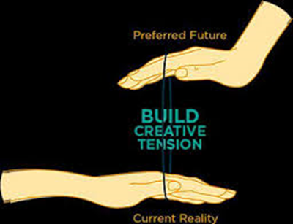
CREATE & BUILD
“We get paid for bringing value to the market place…so we get paid for the value, not the time.”-Jim Robin
How do you currently create wealth?
Think of ways you can leverage your skill sets to increase your value in the market-place?
Think of risks to your ability to make money?
BUILD CREATIVE TENSION – Preferred Future vs Current Reality
Dreams
+
Hard Work
+
Dedication
+
Perseverance
=
SUCCESS

Slide 4
02
FINANCIAL WEALTH/HEALTH
LIVE & ENJOY

Slide 5
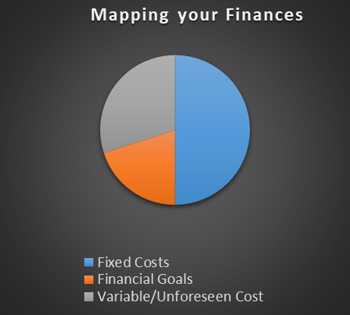
LIVE & ENJOY
“Too many people spend money they earned…to buy things they don’t want…to impress people they don’t like.”- Will Rogers
MAPPING YOUR FINANCES – 50% Fixed Costs + 30% Variable/Unforeseen Cost + 20% Financial Goals = 100% Living a life you can afford
Do a little exercise, describing your current lifestyle for the following 5 areas: a) House; b) Car; c)Hobbies; d) Family; e)Other
Now ask yourself…”am I living a life I can afford with regard to the 5 areas?
Strategies for living DEBT FREE
Tackle biggest debt first
2) Tackle debt with higher interest
3) Pay off credit card debt immediately
4) Consider debt consolidation or debt counselling
5) Sell assets for cash
6) Do not add more debt
30%
30%
20%

Slide 6
03
FINANCIAL WEALTH/HEALTH
SAVE & INVEST

Slide 7
SAVE & INVEST
“Compound interest is the eight wonder of the world. He who understands it earns it…he who doesn’t …pays it”- Albert Einstein
There are lost of good reasons to save and invest:
You earn interest on your money.
You have cash available when you need it.
You can afford to buy the things you really need.
Your money can work for you.
Time in the market matters.
Start saving early, encourage your children to do the same.
What goals are you saving for?
Getting married?
Children’s education?
Retirement at 65years?
Medical expenses?
536 870 912
PLAN & PROTECT
“Money is a tool. It will take you wherever you wish, but it will not replace you as the driver.” – Ayn Rand
What steps have you taken to protect you and your family?
Insurance = (Protection + Provision) Will = Allocation of assets / business at death
Risk

Slide 8
04
FINANCIAL WEALTH/HEALTH
SHARE & LEGACY

Slide 9
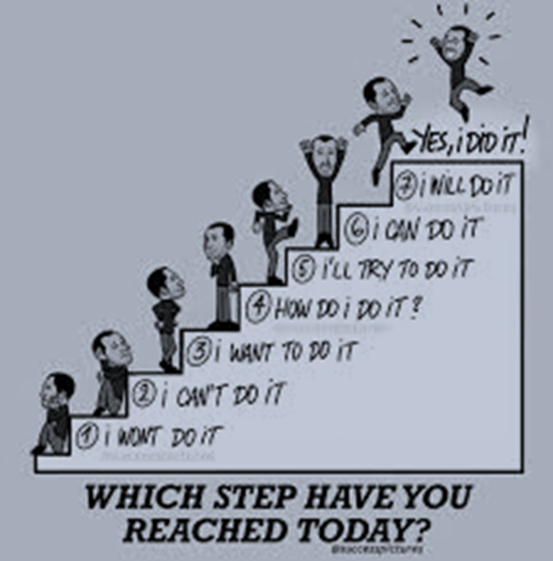
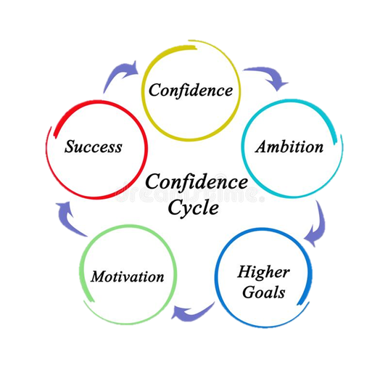
Share & legacy
“It is every man’s obligation to put back into to the world at least the equivalent of what he takes out of it.” – Albert Einstein
Set up a philanthropic foundation
Leave an inheritance for loved ones
Start a family business
Passion investments
Alternative investments
Think about ways in which you would like to use your time,
passions and money to make a positive difference.

Slide 10
05
FINANCIAL WEALTH/HEALTH
WHAT DOES THE BANK OFFER?

Slide 11
FINANCING MICRO/SMALL/MEDIUM ENTERPRISES
CREDIT GUARANTEE SCHEME
The journey towards the implementation of these facilities started in earnest with the launching of the Namibia Financial Sector Strategy in 2012, which identified five key strategic areas of reform, namely:
• Deepening and developing our financial markets;
• Provision of financial safety net;
• Enhancement of financial inclusion;
• Localisation of the Namibian financial sector; and
• Development of critical skills needed in the financial sector
In process of finalization:
5 year SME Loan Scheme to bring relief in terms of working capital, zerorised interest rates and repayment only start in month 7 as announced by Minister of Finance, Honorable Ipumbu Shiimi, on 19th November 2020.

Slide 12
Thank you

